Slide 1

Introduction to RTL Design
Register Transfer Level

Slide 2


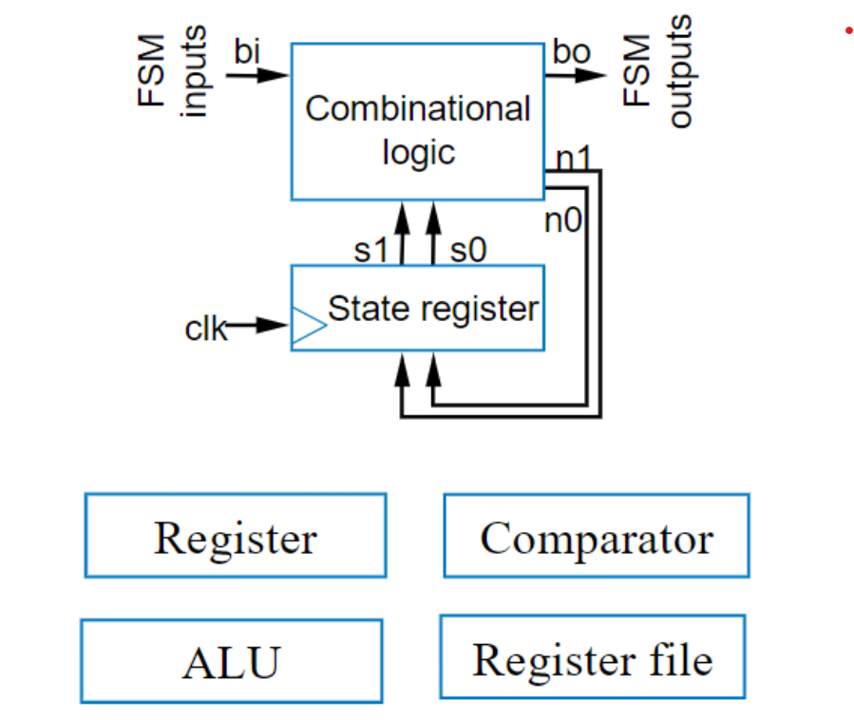
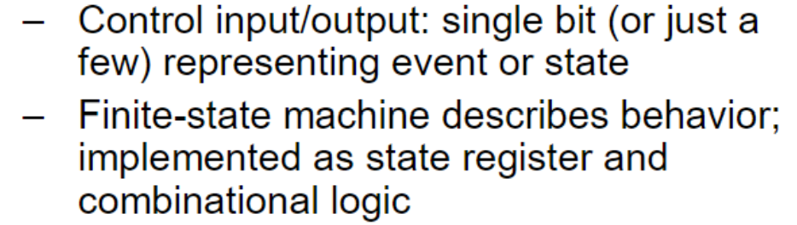

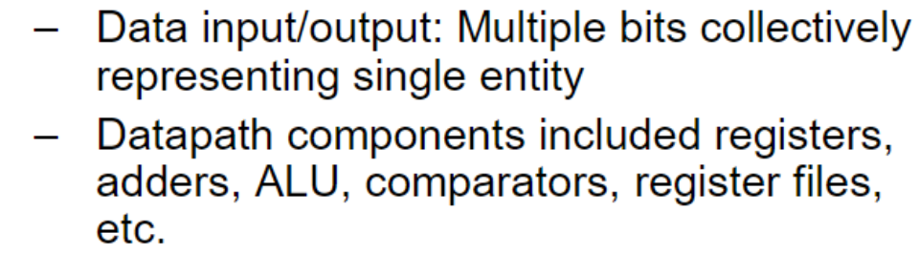
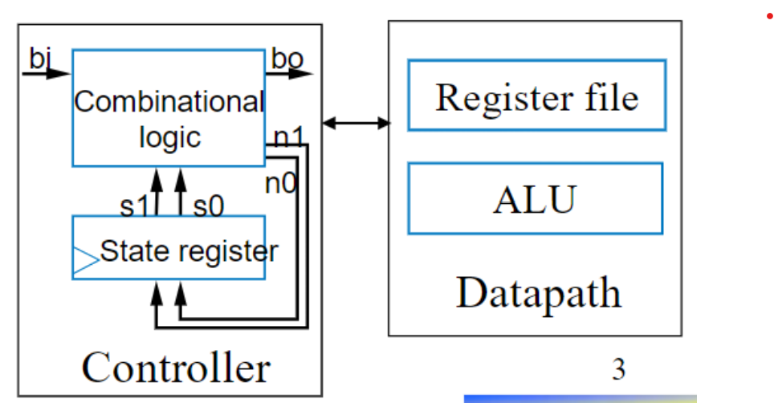

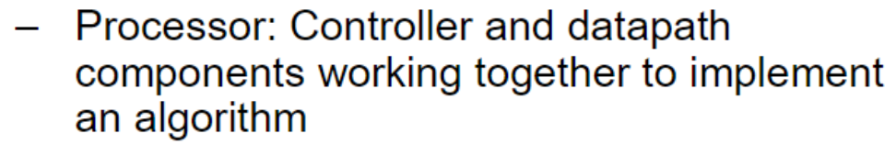
RTL Design
RTL Design Method
5.2
3

Slide 3
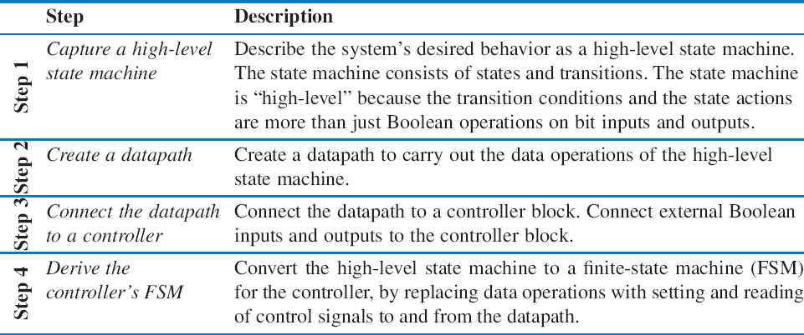
RTL Design
RTL Design Method
5.2
3

Slide 4

RTL Design
RTL Design Method: “Preview” Example
Soda dispenser
c: bit input, 1 when coin deposited
a: 8-bit input having value of deposited coin
s: 8-bit input having cost of a soda
d: bit output, processor sets to 1 when total value of deposited
s
a
c d
Soda dispenser processor
s
a 25
25
coins equals or exceeds cost of ₀ ₁ ₀ ₁ ₀
50
a soda
c d
0 1 0
Soda _{tot:}
dispenser processor50
tot:
25
a
How can we precisely describe this processor’s behavior?
4

Slide 5
RTL Design
Preview Example: Step 1 – Capture High-Level State Machine
s a
8 8
Declare local register tot
Init state: Set d=0, tot=0
Wait state: wait for coin
If see coin, go to Add state
Add state: Update total value: tot = tot + a
Remember, a is present coin’s value
Go back to Wait state
In Wait state, if tot >= s, go to
Disp(ense) state
Disp state: Set d=1 (dispense soda)
Return to Init state
c d
Soda
dispenser processor
Inputs: c (bit), a (8 bits), s (8 bits) Outputs: d (bit)
Local registers: tot (8 bits)
c
Add
Init Wait
tot=tot+a c’*(tot<s)
d=0 tot=0
c’*(tot<s)’
Disp
d=1
5

Slide 6



RTL Design
Preview Example: Step 2 – Create Datapath
Inputs : c (bit), a(8 bits) , s (8 bits) Outputs : d (bit)
Need tot register
Need 8-bit comparator to compare s and tot
Need 8-bit adder to perform tot = tot + a
Local reg isters: t ot (8 bits)
c
Add
Init
Wait
tot= t ot+a c‘ *(tot<s)
d=0
t ot=0
^{c‘ (t}ot<s)‘
Disp
s
a
d=1
Wire the components as needed for above
Create control input/ outputs, give them names
tot_ld tot_clr
^{ld} tot clr
8
8 8
tot_lt_s
8-bit
<
8-bit adder
Datapath
8
6

Slide 7
RTL Design
Preview Example: Step 3 – Connect Datapath to a Controller
s
a
Controller’s inputs
External input c (coin detected)
Input from datapath comparator’s output,
tot_ld tot_clr
ld clr
tot
8
8 8
tot_lt_s
8-bit
8-bit adder
<
Datapath
8
s a
which we named
tot_lt_s
Controller’s outputs
External output d
(dispense soda)
Outputs to datapath to load and clear the tot register
8 8
c
d
tot_ld
tot_clr
Controller _{tot_lt_s} Datapath
7

Slide 8


RTL Design
Preview Example: Step 4 – Derive the Controller’s FSM
s a
8 8
Same states and arcs as high-level state machine
But set/read datapath control signals for all
Datapath
c
d
tot_ld
Controller
tot_clr
tot_lt_s
s
a
Inputs::c, tot_lt_s (bit) Outputs:d, tot_ld, tot_clr (bit)
c
tot_ld tot_clr
tot_ld
^{ld} tpt
clr
datapath operations
c
8
Add
tot_clr
8 8
d
Init Wait
d=0 tot_clr=1
tot_ld=1 c’*tot_lt_s
tot_lt_s
tot_lt_s
8-bit
8-bit adder
and conditions
<
Datapath
8
_{c’*} tot_lt_s’
Disp
Controller
d=1
8

Slide 9
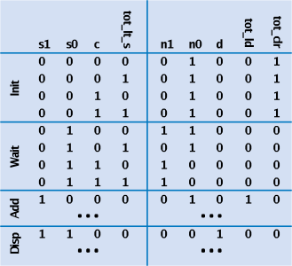


RTL Design
Preview Example: Completing the Design
Implement the FSM as a state register and logic
As in Ch3
Table shown on right
Inputs::c, tot_lt_s (bit) Outputs:d, tot_ld, tot_clr (bit)
c
tot_ld
c
Add
tot_clr
d
Init Wait
d=0 tot_clr=1
tot_ld=1 c’*tot_lt_s
tot_lt_s
_{c’*} tot_lt_s’
Disp
Controller
d=1
9

Slide 10
RTL Design
High-Level State Machine
Soda dispenser example
Not an FSM because:
Multi-bit (data) inputs a and s
Local register tot
Data operations tot=0, tot<s, tot=tot+a.
Useful high-level state machine:
Data types beyond just bits
Local registers
Arithmetic equations/expressions
Inputs: c (bit), a (8 bits), s (8 bits)
Outputs: d (bit)
Local registers: tot (8 bits)
c
Init Wait
tot= tot+a c’ (tot<s)
d=0 tot=0
c’(tot<s)’
Disp
d=1
10

Slide 11
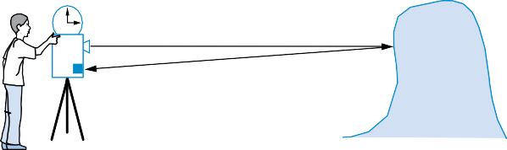
RTL Design
Step 1 Example: Laser-Based Distance Measurer
T (in seconds)
laser
D
Object of interest
sensor
2D = T sec * 3*10⁸ m/sec
Example of how to create a high-level state machine to describe desired processor behavior
Laser-based distance measurement – pulse laser, measure time T to sense reflection
Laser light travels at speed of light, 3*10 m/sec
Distance is thus D = T sec * 3*10⁸ m/sec / 2
8
11

Slide 12
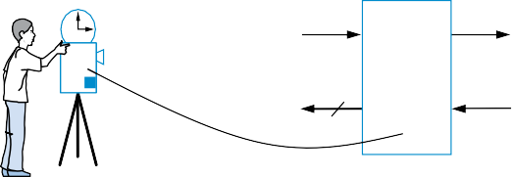
RTL Design
Step 1 Example: Laser-Based Distance Measurer
T (in seconds)
laser
from button ^{B}
L
to laser
Laser-based distance measurer
sensor
D
to display
16
S
from sensor
Inputs/outputs
B: bit input, from button to begin measurement
L: bit output, activates laser
S: bit input, senses laser reflection
D: 16-bit output, displays computed distance
12

Slide 13
RTL Design
Step 1 Example: Laser-Based Distance Measurer
Laser- based distance measurer
from button ^{B}
^{L} to laser
Inputs: B, S(1 bit each) Outputs: L (bit), D (16 bits)
D 16
to display
S
from sensor
S0
?
a
L = 0 (laser off)
D = 0 (distance = 0)
Step 1: Create high-level state machine
Begin by declaring inputs and outputs
Create initial state, name it S0
Initialize laser to off (L=0)
Initialize displayed distance to 0 (D=0)
13

Slide 14
RTL Design
Step 1 Example: Laser-Based Distance Measurer
Inputs: B, S (1 bit each) Outputs: L (bit), D (16 bits)
Laser- based distance measurer
from button ^{B}
^{L} to laser
B’ (button not pressed)
D 16
S
to display
from sensor
a
S0
S1
?
B
L = 0
D = 0
(button pressed)
Add another state, call S1, that waits for a button press
B’ – stay in S1, keep waiting
B – go to a new state S2
Q: What should S2 do? A: Turn on the laser
a
14

Slide 15
RTL Design
Step 1 Example: Laser-Based Distance Measurer
Inputs: B, S (1 bit each) Outputs: L (bit), D (16 bits)
Laser- based distance measurer
from button ^{B}
^{L} to laser
to display
D 16
S
from sensor
B’
S0
L = 0
D = 0
S1
B
S2
L = 1
(laser on)
S3
L = 0
(laser off)
a
Add a state S2 that turns on the laser (L=1)
Then turn off laser (L=0) in a state S3
Q: What do next? A: Start timer, wait to sense reflection
a
15

Slide 16
RTL Design
Step 1 Example: Laser-Based Distance Measurer
Inputs: B, S (1 bit each) Outputs: L (bit), D (16 bits) Local Registers: Dctr (16 bits)
B’ S’ (no reflection)
from button ^{B}
^{L} to laser
Lasre-based
D 16
distance measruer
S
to dispaly
from sensor
S (reflection)
?
S0
L = 0
D = 0
S1
S2
L = 1
S3
B
Dctr = 0 (reset cycle count)
L = 0
Dctr = Dctr + 1 (count cycles)
a
Stay in S3 until sense reflection (S)
To measure time, count cycles for which we are in S3
To count, declare local register Dctr
Increment Dctr each cycle in S3
Initialize Dctr to 0 in S1. S2 would have been O.K. too
16

Slide 17
RTL Design
Step 1 Example: Laser-Based Distance Measurer
from button ^{B}
Lasre-based distance measruer
^{L} to laser
Inputs: B, S (1 bit each) Outputs: L (bit), D (16 bits) Local Registers: Dctr (16 bits)
B’ S’
D 16
to dispaly
S
from sensor
S0 L = 0
D = 0
S1
Dctr = 0
S2 L = 1
a
B
S3
S
S4
L=0 D = Dctr / 2
Dctr = Dctr + 1 (calculate D)
Once reflection detected (S), go to new state S4
□ Calculate distance
8
□ Assuming clock frequency is 3x10 , Dctr holds number of meters, so D=Dctr/2
After S4, go back to S1 to wait for button again
17

Slide 18
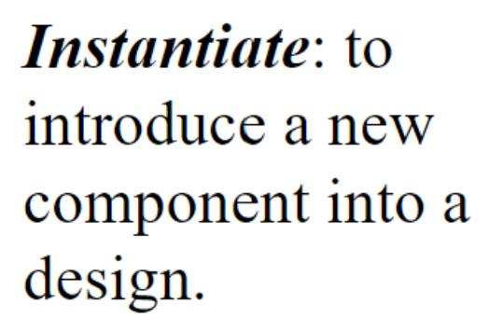
RTL Design
Step 2: Create a Datapath
Datapath must
Implement data storage
Implement data computations
Look at high-level state machine, do three substeps
(a) Make data inputs/outputs be datapath inputs/outputs
(b) Instantiate declared registers into the datapath (also instantiate a register for each data output)
(c) Examine every state and transition, and instantiate datapath components and connections to implement any data computations
18

Slide 19
RTL Design
Step 2 Example: Laser-Based Distance Measurer
Inputs: B, S (1 bit each) Outputs: L (bit), D (16 bits) Local Registers: Dctr (16 bits)
B‘ S‘
Make data inputs/ outputs be datapath inputs/ outputs
Instantiate declared registers into the datapath (also instantiate a register for each
S0 L = 0
D = 0
S1
Dctr = 0
S2 L = 1
S3
S4
B
S
L=0 D = Dctr / 2 Dctr = Dctr + 1 (calculate D)
data output)
(c) Examine every state ^{Dreg_clr}
a
Datapath
and transition, and
Dreg_ld
instantiate datapath _{Dctr_clr}
clear count
clear load
I
components and connections to implement any data computations
Dctr_cnt
Dctr: 16-bit up-counter
Dreg: 16-bit register
Q
Q
16
D
19

Slide 20

RTL Design
Step 2 Example: Laser-Based Distance Measurer
Inputs: B, S (1 bit each) Outputs: L (bit), D (16 bits) Local Registers: Dctr (16 bits)
B‘ S‘
(c) (continued) Examine every state and transition, and instantiate datapath components and connections to implement any data computations
S0 L = 0
D = 0
S1
Dctr = 0
S2 L = 1
S3 S4
B
S
L=0 D = Dctr / 2 Dctr = Dctr + 1 (calculate D)
Datapath
a
Dreg_clr Dreg_ld
Dctr_clr Dctr_cnt
>>1
16
clear count
clear load
I
Dctr: 16-bit up-counter
Dreg: 16-bit register
Q
Q
16
16
D
20

Slide 21
RTL Design
Step 2 Example Showing Mux Use
Localregisters:
E, F, G, R (16 bits)
E
F G
E
F G
E
F G
T0 R = E + F
add_A_s0 add_B_s0
A ₊ B
A ₊ B
2×⋅ 1 2⋅×1
T1 R = R + G
A ₊ B
a
R
R
(a)
(b)
(c)
R
(d)
Introduce mux when one component input can come from more than one source
21

Slide 22

RTL Design
Step 3: Connecting the Datapath to a Controller
B
L
to laser
from button
Controller
from sensor
Dreg_clr
Datapath
S
Laser-based distance measurer example
Easy – just connect all control signals between controller and datapath
Dreg_ld
Dctr_clr
Dctr_cnt
D
to display
16
300 MHz Clock
Datapath
Dreg_clr Dreg_ld
Dctr_clr Dctr_cnt
>>1
16
clear count
Dctr: 16-bit up-counter
clear load
^{I} Dreg: 16-bit
register
Q
Q
16
16
D
22

Slide 23
RTL Design
Step 4: Deriving the Controller’s FSM
Inputs: B, S (1 bit each) Outputs: L (bit), D (16 bits) Local Registers: Dctr (16 bits)
B’ S’
B
from button
Controller
L
to laser
from sensor
Dreg_clr
S
Dreg_ld
Dctr_clr
Datapath
S0
L = 0
D = 0
S1
Dctr = 0
S2
L = 1
S3
S4
Dctr_cnt
B
S
to dispal y
D
L=0 D = Dctr / 2 Dctr = Dctr + 1 (calculate D)
16
300 MHz Clock
FSM has same
Inputs: B, S
Outputs: L, Dreg_clr, Dreg_ld, Dctr_clr, Dctr_cnt
structure as high- level state machine
Inputs/outputs all bits now
Replace data operations by bit operations using datapath
B’
S’
a
S0
S1
B
S2
S3
S
S4
L = 0 L = 0
Dreg_clr = 1 Dreg_clr = 0
L = 1 L = 0 L = 0
Dreg_clr = 0 Dreg_clr = 0 Dreg_clr = 0
Dreg_ld = 0
Dctr_clr = 0
Dctr_cnt = 0 (laser off) (clear D reg)
Dreg_ld = 0
Dctr_clr = 1
Dctr_cnt = 0 (clear count)
Dreg_ld = 0 Dreg_ld = 0
Dctr_clr = 0 Dctr_clr = 0
Dctr_cnt = 0 Dctr_cnt = 1
Dreg_ld = 1
Dctr_clr = 0
Dctr_cnt = 0
(load D reg with Dctr/2)
(laser on)
(laser off) (count up)
(stop counting)
23

Slide 24
RTL Design
Step 4: Deriving the Controller’s FSM
B’
S’
S0
S1
B
S2
S3
S
S4
L = 0 L = 0 L = 1 L = 0 L = 0
Dreg_clr = 1 Dreg_clr = 0 Dreg_clr = 0 Dreg_clr = 0 Dreg_clr = 0
Dreg_ld = 0 Dreg_ld = 0 Dreg_ld = 0 Dreg_ld = 0 Dreg_ld = 1
Dctr_clr = 0 Dctr_clr = 1 Dctr_clr = 0 Dctr_clr = 0 Dctr_clr = 0
Dctr_cnt = 0 Dctr_cnt = 0 Dctr_cnt = 0 Dctr_cnt = 1 Dctr_cnt = 0
(laser off) (clear count) (laser on) (clear D reg)
(laser off) (load D reg with Dctr/2) (count up) (stop counting)
Using
Inputs: B, S Outputs: L, Dreg_clr, Dreg_ld, Dctr_clr, Dctr_cnt
B’ S’
shorthand of outputs not assigned implicitly assigned 0
a
S0
S1
B
S2
S3
S
S4
L = 0 Dctr_clr = 1
^{Dreg_clr = 1} (clear count) (laser off)
(clear D reg)
L = 1
(laser on)
L = 0
Dctr_cnt = 1
(laser off) (count up)
Dreg_ld = 1
Dctr_cnt = 0
(load D reg with Dctr/2)
(stop counting)
24

Slide 25
RTL Design
Step 4: Deriving the Controller’s FSM
from button ^{B}
Controller
^{L} to laser _{S}from sensor
Dreg_clr
Datapath
Dreg_clr
>>1
Dreg_ld
Datapath
Dreg_ld
Dctr_clr Dctr_cnt
16
Dctr_clr Dctr_cnt
clear count
Dctr: 16-bit up-counter
Q
clear load
I
Dreg: 16-bit register
to display
D
Q
16 300 MHz Clock
16
16
D
Inputs: B, S Outputs: L, Dreg_clr, Dreg_ld, Dctr_clr, Dctr_cnt
B’ S’
S0
S1
B
S2
S3
S
S4
L = 0 Dctr_clr = 1
^{Dreg_clr = 1} (clear count) (laser off)
(clear D reg)
L = 1
(laser on)
L = 0
Dctr_cnt = 1
(laser off) (count up)
Dreg_ld = 1
Dctr_cnt = 0
(load D reg with Dctr/2)
(stop counting)
25

Slide 26
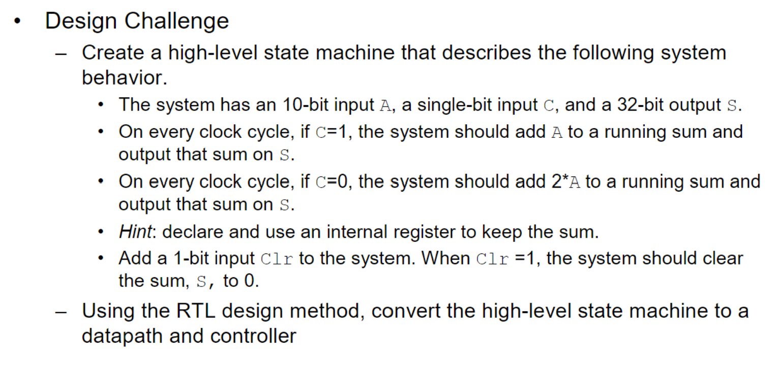
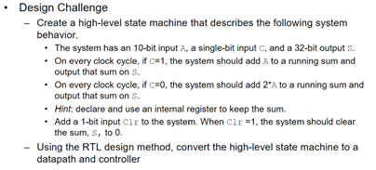
RTL Design
Design Challenge
25

